Slide 1
Generating Semantically Similar Permutations
of Questions
Improving question answering systems through data augmentation
with question generation
By: Leung Cheuk Yui
4 May 2020
SCSE19-0007

Slide 2
BACKGROUND
01
PROBLEM STATEMENT
02
TABLE OF CONTENTS
05
METHODOLOGY
RELATED WORK
03
06
EXPERIMENTS & RESULTS
OBJECTIVE / SCOPE
04
07
CONCLUSION
2

Slide 3




BACKGROUND - FAQ & CHATBOTS
Due to the advancements and breakthroughs in natural language processing (NLP) and understanding (NLU) in recent years, traditional frequently-asked-questions (FAQ) sections on web pages are gradually replaced with interactive chatbots and virtual assistants.
Examples:
NTU’s Lyon Chat Bot
The Jamies @ Ask Jamie
Information retrieval techniques combined with NLP/NLU models based on deep learning.

Slide 4
BACKGROUND - TECHNOLOGY BEHIND QUESTION ANSWERING MODELS
Deep learning: A branch of machine learning algorithms based on the artificial neural networks.
Artificial neural networks: A type of computing systems inspired by how biological brains work. They can be “taught” to perform certain tasks without explicitly being programmed by humans.
Training Model:
Compare with label
After training:
Q1 | A1
Q2 | A2
Q3 | A3
Adjust
A1
Artificial Neural Network
Artificial Neural Network
(After Training)
Q1
Predict
A3
Qnew
Predict
A4
…
…
Qn | An

Slide 5
BACKGROUND - TECHNOLOGY BEHIND QUESTION ANSWERING MODELS
Deep learning is a data driven process which requires massive amounts of data.
It is common to use millions or billions of training examples to train deep neural networks.
Some examples include:
OpenAI’s GPT-2 language model [1] uses 8 million web pages as training data.
Google’s latest universal neural machine translation system [2] is trained over 25 billion examples.

Slide 6
BACKGROUND – CHINESE INFLUENCE IN ENGLISH SPEAKERS
74.4% of Singapore’s population are Chinese residents. [3]
Chinese is the second most spoken language at home (34.9%). [4]
Some Chinese language influence in English sentences by Chinese Singaporeans.
One example include:
“How to go to NTU?”
“如何去NTU?”
How to | go to | NTU?
如何 | 去 | NTU?

Slide 7
PROBLEM STATEMENT
In standard FAQ sections, there are only around hundreds or thousands of question-answer pairs.
To train an accurate and robust question-answering model, more training data is required.
Human annotators can manually generate different ways to ask a single question, but it is too time-consuming and expensive.

Slide 8
PROBLEM STATEMENT
Most question-answer pairs are in formal English language.
Some Chinese language influence in English sentences by Chinese Singaporeans.
To build a question-answering model that understands English sentences with Chinese language influence, more data with Chinese language influence is required to train the model.

Slide 9
RELATED WORK – RULE-BASED QUESTION GENERATION [5]
Define context-free grammar
Large set of rules are handcrafted to identify the key purpose of the question.
However, handcrafting the rules are tedious and expensive.

Slide 10
RELATED WORK – NEURAL QUESTION GENERATION [6]
Generate questions from text passages.
Apply neural encoder - decoder model.
The encoder reads the input text and the answer position.
The encoder will output an answer-aware input representation.
This output is fed to the decoder to generate an answer focused question.

Slide 11
RELATED WORK – NEURAL MACHINE TRANSLATION [7]
Similar to neural networks.
Apply neural encoder - decoder model.
The encoder reads the input English text.
The encoder will output a single vector representation.
This output is fed to the decoder to generate a sentence in the designated language.
However, this approach requires a large corpus.

Slide 12
RELATED WORK – EASY DATA AUGMENTATION (EDA) [8]
Synonym Replacement: Choose n words from the sentence randomly that are not stop words and replace each of these words with one of its synonyms chosen at random.
Random Insertion: Randomly choose n words from the sentence that are not stop words and insert synonyms into the sentence at random position.
Random Swap: Randomly choose two words in the sentence and swap their positions. Do this n times.
Random Deletion: Randomly remove each word in the sentence with probability p.
insert
delete
Is it compulsory to attend lectures?
It is a must to attend lectures?
swap
replace

Slide 13
PROPOSED SOLUTION – QG SYSTEM
QG system is a question generation engine that can generate different ways of asking the same questions automatically.
It also can generate English questions with Chinese language influence.
To generate training data for the Singapore based question answering model.
An example of different ways
to ask the same question:
How to apply for NTU?
What are the admission requirements for NTU?
What are the criteria to enter NTU?
Where can I know more about getting into NTU?

Slide 14
OBJECTIVES
Improve
Improve question answering models through implementing automatic question generation engine
Evaluate
Evaluate the effectiveness of question generation
Analyze
Analyze quality of generated questions

Slide 15
SCOPE
Questions Generation: Implement question generation engine to generate permutations of questions with Chinese language influence.
Evaluation and Analysis: Effectiveness of question generation engine. Measure grammaticality, degree of semantic preservation and lexical diversity of generated questions.
Data is limited to data regarding commonly asked questions about Baby Bonus Scheme from the Ministry of Social and Family Development (MSF).

Slide 16
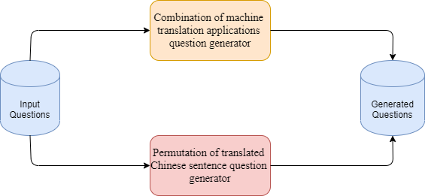
METHODOLOGY – SYSTEM ARCHITECTURE

Slide 17
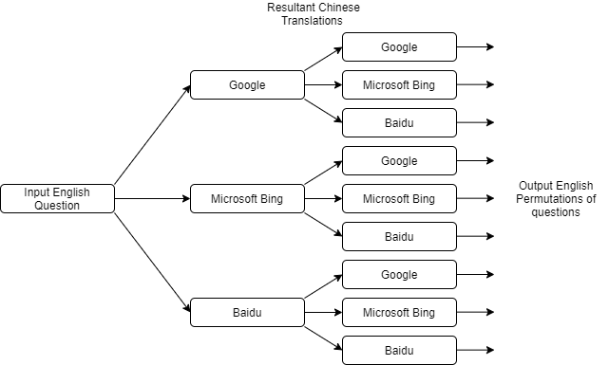
METHODOLOGY – Combination of machine translation applications question generator

Slide 18
METHODOLOGY – Combination of machine translation applications question generator
Select different machine translation applications
Capable of producing n^2 possible permutations where n is the number of machine translation applications used
Utilising more machine translation applications might result in duplicate results hence, limiting to only using 3 to 4 will be sufficient.

Slide 19
METHODOLOGY – Permutation of translated Chinese sentence question generator
Input Question
How is the birth order determined?
Machine Translation Application
Translate English question to Chinese language.
如何确定出生顺序?
Segment the Chinese question into phrases
Segmented Chinese question
如何 | 确定 | 出生 | 顺序?
如何确定出生顺序?
如何确定出生 | 顺序?
如何确定 | 出生 | 顺序?
…
8. 如何 | 确定 | 出生 | 顺序?
Generate Permutations of the segmented Chinese question

Slide 20
METHODOLOGY – Permutation of translated Chinese sentence question generator
如何确定出生顺序?
如何确定出生 | 顺序?
如何确定 | 出生 | 顺序?
…
8. 如何 | 确定 | 出生 | 顺序?
Generate Permutations of the segmented Chinese question
Machine Translation
Application – Translate each individual segmented phrase back to English language.
How to determine the birth order
How to determine birth | order
How to determine | born | order
…
8. How is it | determine | born | order
Join the segmented English questions back to a full question
1. How to determine the birth order
2. How to determine birth order
3. How to determine born order
…
8. How is it determine born order

Slide 21
METHODOLOGY – Permutation of translated Chinese sentence question generator
From the previous example, the translated Chinese question has 4 individual segments after segmenting.
A Chinese sentence with 4 individual segments will have 3 spaces as shown below:
如何 | 确定 | 出生 | 顺序?
As there are 3 spaces, there will be 2^3 = 8 permutations.
Therefore, if the translated Chinese question has N phrases, there will be 2^(N – 1) permutations.

Slide 22
METHODOLOGY – Permutation of translated Chinese sentence question generator
Due to the direct translation of individual segments of the Chinese question back to English language, we can retain the Chinese sentence structure.
Hence, retaining Chinese language influence in the generated translated English question.

Slide 23
EXPERIMENTS – ANALYSIS
Fluency
Flesch Reading Ease score [9] is introduced to measure the fluency and grammaticality correctness by considering various features such as spellings, language models, etc.
Generates a score ranging from 0 to 100 (the higher the better).
Aim to produce English sentences with Chinese language influence, the score will be preferred to be around 50 to 80.

Slide 24
EXPERIMENTS – ANALYSIS
Semantic Similarity/Meaning Preservation
Using word sense disambiguation and compare the semantic similarity between the input questions and generated questions. [10]
Generates a score ranging from 0 to 0.5 (the higher the better)
Aim to produce semantically similar permutations of questions hence, score is preferred to be the higher the better.

Slide 25
EXPERIMENTS – ANALYSIS
Lexical Diversity
Sentences are converted to vector representations and the cosine angle measured between the vectors will be the cosine similarity score. [11]
Generates a score ranging from 0 to 1 (the higher the more similar)
Aim to produce a variety of permutations of questions, the score will be preferred to be the lower the better.

Slide 26
EXPERIMENTS – Combination of machine translation applications question generator

Slide 27
EXPERIMENTS – Combination of machine translation applications question generator

Slide 28
EXPERIMENTS – Combination of machine translation applications question generator

Slide 29
EXPERIMENTS – Permutation of translated Chinese sentence question generator

Slide 30
EXPERIMENTS – Permutation of translated Chinese sentence question generator

Slide 31
EXPERIMENTS – Permutation of translated Chinese sentence question generator

Slide 32
EXPERIMENTS – EVALUATION
Second approach (Permutation of translated Chinese sentence question generator) performs better than the first approach (Combination of machine translation applications question generator)
Second approach retains a higher Chinese language influence in the generated questions and is capable of producing more permutations if the length of the input English question is longer.

Slide 33


CONCLUSION
Improve performance of chat bots/virtual assistants
Future works for question generation

Slide 34
REFERENCES
[1] Radford, Alec, et al. "Language models are unsupervised multitask learners." OpenAI Blog 1.8 (2019).
[2] Arivazhagan, Naveen, et al. "Massively multilingual neural machine translation in the wild: Findings and challenges." arXiv preprint arXiv:1907.05019 (2019).
[3] S. D. o. Statistics, Population trends, 2019, 2019.
[4] P. Lee, “English most common home language in Singapore, bilingualism also up: Government survey”, The Straits Times, 2016
[5] L. Pan, W. Lei, T.-S. Chua, and M.-Y. Kan, “Recent advances in neural question generation,” arXiv preprint arXiv:1905.08949, 2019.
[6] Zhou, Q., Yang, N., Wei, F., Tan, C., Bao, H., & Zhou, M. (2017, November). Neural question generation from text: A preliminary study. In National CCF Conference on Natural Language Processing and Chinese Computing (pp. 662-671). Springer, Cham.
[7] N. Kalchbrenner and P. Blunsom, “Recurrent continuous translation models,” in Proceedings of the 2013 Conference on Empirical Methods in Natural Language Processing, 2013, pp. 1700–1709.
[8] J. W. Wei and K. Zou, “Eda: Easy data augmentation techniques for boosting performance on text classification tasks,” arXiv preprint arXiv:1901.11196, 2019.
[9] A. Kher, S. Johnson and R. Griffith, “Readability Assessment of Online Patient Education Material on Congestive Heart Failure.,” Advances in preventive medicine, 2017, 9780317. [Online]. Available: https://doi.org/10.1155/2017/9780317
[10] N. D. Thanh and T. Simpson, “Measuring Similarity between sentences,” 2018
[11] B. Li and L. Han, “Distance Weighted Cosine Similarity Measure for Text Classification,” in Intelligent Data Engineering and Automated Learning – IDEAL 2013, 2013, pp. 611 – 618.

Slide 35
IMAGE CREDITS
NTU’s Lyon Chatbots https://admissions.ntu.edu.sg/Pages/Home.aspx
Ask Jamie @ MSF https://www.msf.gov.sg/Pages/default.aspx
Ask Jamie @ SCDF https://www.scdf.gov.sg/
Ask Jamie @ SPF https://www.police.gov.sg/

Slide 36
THANK YOU

